Slide 1
ER-4
13.4

Slide 2
Contents
Entity Relationship(ER) diagram
ER Diagram Symbols

Slide 3
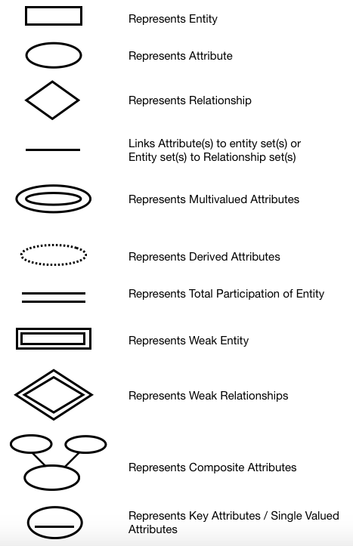
Notations

Slide 4
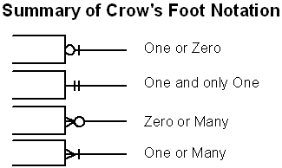
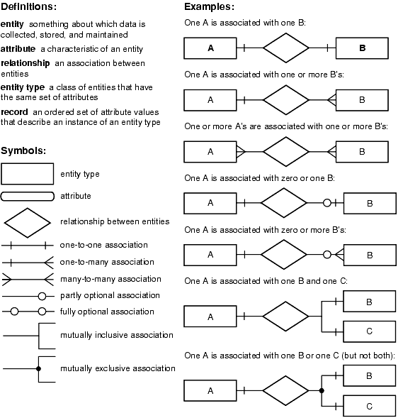
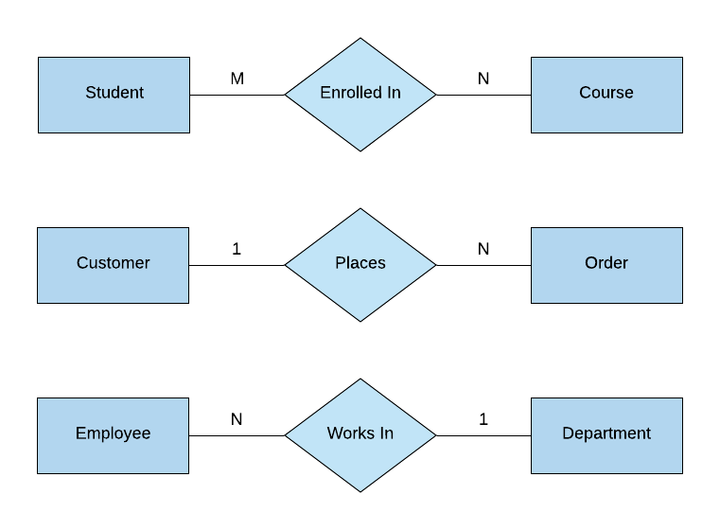
Notations

Slide 5
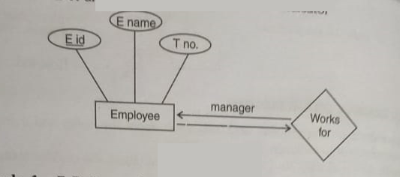
ER Diagram Example
E-R diagram for employee with role indicator.

Slide 6
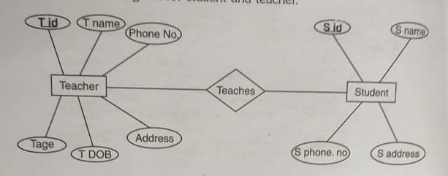
ER Diagram Example
E-R diagram for student and teacher.

Slide 7
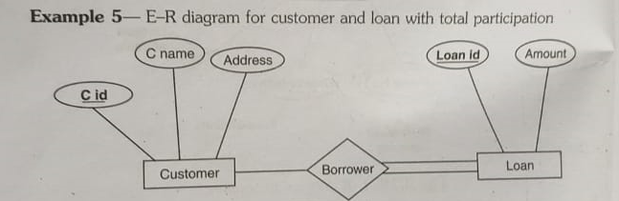
ER Diagram Example

Slide 8
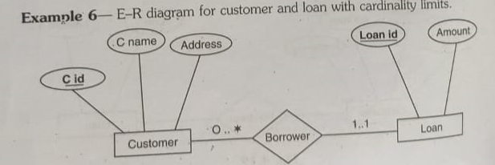
ER Diagram Example

Slide 9
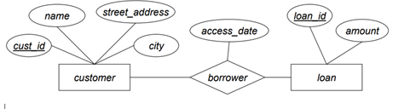
ER Diagram for customer and loans

Slide 10
EasyShop Retail Application Case Study
1. One supplier can provide many quotations.
2. For every item, there will be a separate quotation.
3. Many suppliers can quote for the same item.
4. Many items can be outward to the several retail outlets.
5. One employee works for only one retail outlet.
6. One retail outlet can have many employees.
7. Many customers can purchase items from several retail outlets.
8. One employee can nominate many dependents

Slide 11
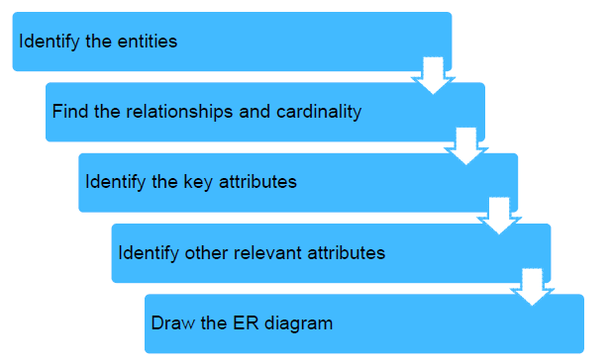
Developing ER Model

Slide 12
Steps in ER Modeling (1 of 5)
Step 1: Identify the entities
Supplier
Quotation
Item
RetailOutlet
Employee
Customer
Dependent

Slide 13


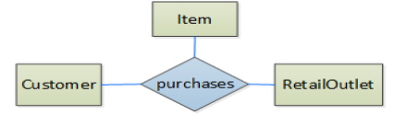
Steps in ER Modeling (2 of 5)

Slide 14
Steps in ER Modeling (3 of 5)
Step 3: Identify key attributes
Supplier supplierid
Quotation quotationid
Item itemcode
RetailOutlet retailoutletid
Employee empid
Customer customerid
Dependent

Slide 15
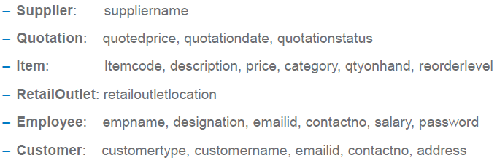
Steps in ER Modeling (4 of 5)
Step 4: Identify other relevant attributes

Slide 16
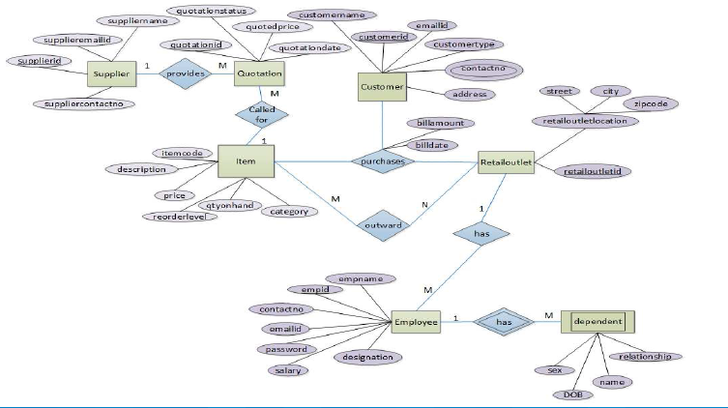
Steps in ER Modeling (5 of 5)

Slide 17
Questions
1. Construct an ER diagram for hospital with a set of patient and medical doctors. Associate
with each patient a log of various tests and examination conducted.
2. Construct an E-R diagram for Airline Reservation System.
3. Construct an E-R diagram for Banking System
4. Consider a database used to record the marks that student gets in different exams of
different course offerings. Construct an ER diagram that models exams as entities, and
uses a ternary relationship for the considered database.
5. A university registrar’s office maintains data about the following entities: (a) courses,
including number, title, credits, syllabus, and prerequisites; (b) course offerings,
including course number, year, semester, section number, instructor(s), timings, and
classroom; (c) students, including student-id, name, and program; and (d) instructors,
including identification number, name, department, and title. Further, the enrollment of
students in courses and grades awarded to students in each course they are enrolled for
must be appropriately modeled. Construct an E-R diagram for the registrar’s office.
Document all assumptions that you make about the mapping constraints.

Slide 18


